Slide 1
ROMAN EXPRESSIONS
VII

Slide 2
Classroom language

Slide 3
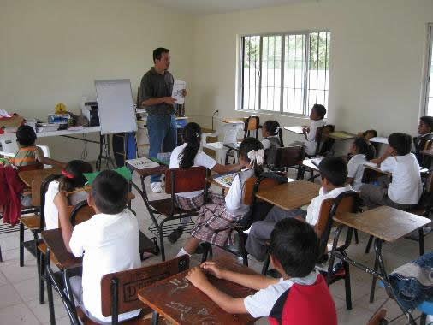
Magister (m) / magistra (f) Discipuli (m. pl) / discipulae (f. pl) Teacher/s - student/s

Slide 4
Potesne me adiuvare? Could you help me?

Slide 5
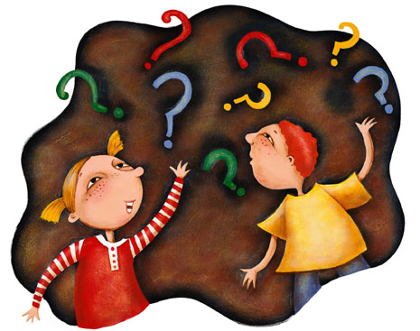
Quomodo … Latine dicitur? How … is said in Latin?

Slide 6
Quid … Anglice significat? What does … mean in English?

Slide 7
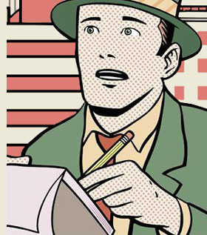
Potesne id iterare, quaeso? Could you repeat, please?

Slide 8
Non id intellego I don’t understand

Slide 9
Id nescio / id non memini I don’t know / I don’t remember

Slide 10
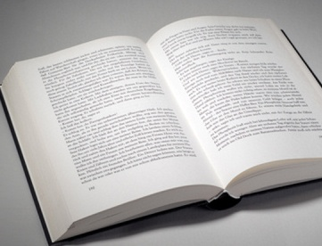
In qua pagina id est? what page it is in?

Slide 11
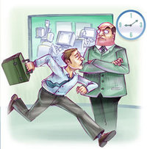
Me paenitet, sero advenio Sorry, I’m late Noli sollicitare, intra… Don’t worry, come in … … et claude ianuam, quaeso … and close the door, please.

Slide 12
Conside (considite pl.), quaeso sit down, please.

Slide 13
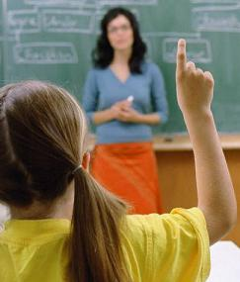
Tace / tacete (pl.) Be quiet / silent Marcus? Adsum (present!) Iulia? Abest (she isn’t)

Slide 14
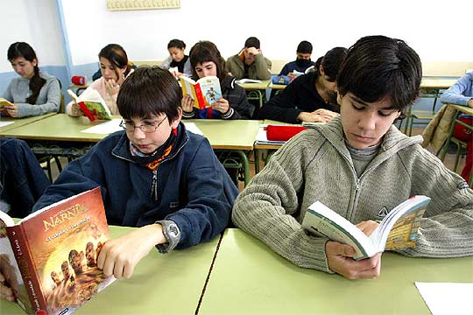
Librum aperi (aperite libros pl.) Open your book/s

Slide 15
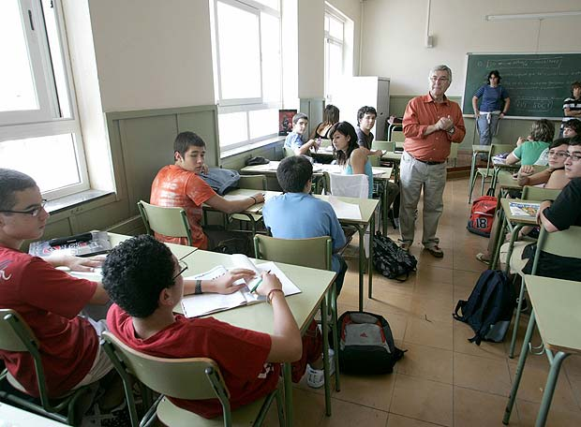
Ignosce mihi, magister; non habeo librum Excuse me, teacher; I don’t have a book

Slide 16
Ubi est librum tuum? Where is your book? Domi reliqui I left it at home

Slide 17
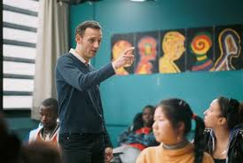
Lege magna voce read aloud perge go on

Slide 18
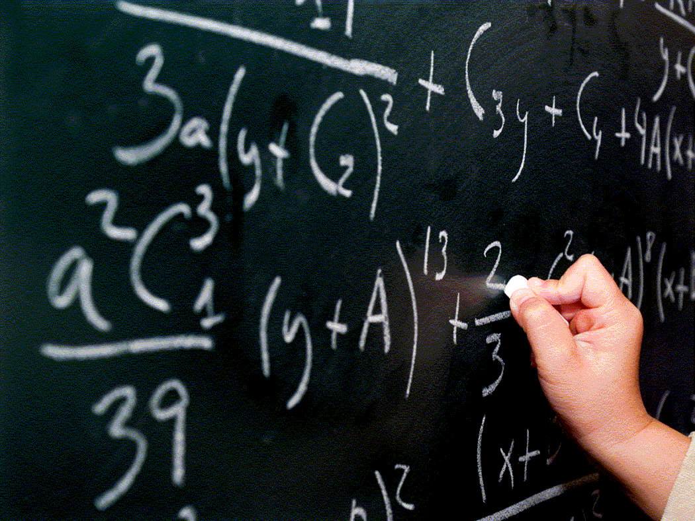
Accede ad tabulam atram / albam go to the black/whiteboard reverte ad sedem take your seat

Slide 19
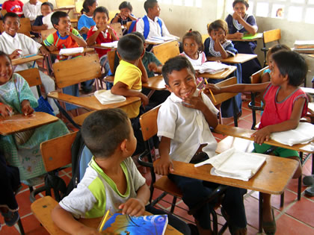
Omitte (omittite pl.) garrulitatem, quaeso cut out the chatter, please

Slide 20
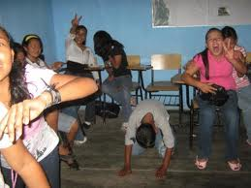
omitte nugas, quaeso cut out the nonsense, please

Slide 21
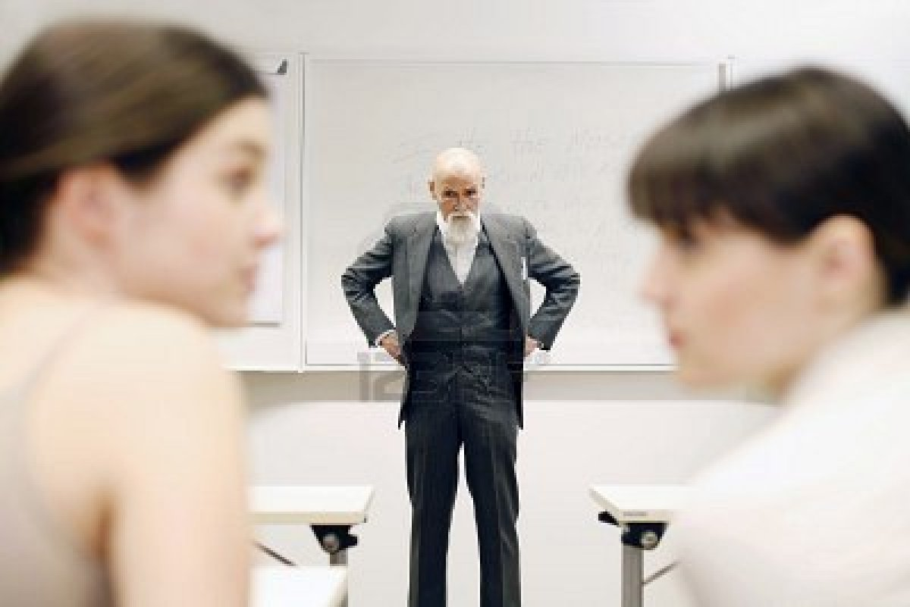
attende / attendite (pl.) pay attention

Slide 22
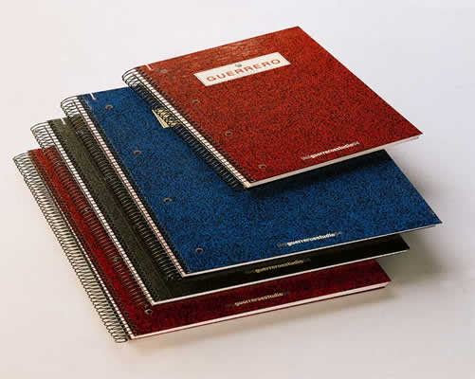
Capite libellos vestros. Get out your notebooks corrigemus exercitia we’re going to correct the exercises

Slide 23
Licetne mihi in latrinam ire? May I go to the toilet? Licet. Yes, ok

Slide 24
Nolite oblivisci perficere pensum vestrum Don’t forget to do your homework

Slide 25
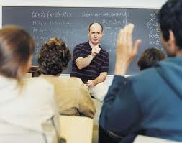
Surge / surgite (pl.), quaeso stand up, please

Slide 26
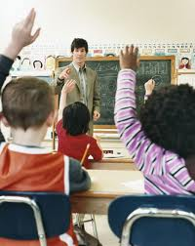
Tolle manum / tollite manus (pl.) raise your hand/s

Slide 27
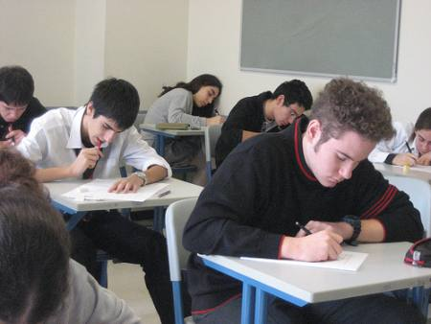
Cras erit probatio tomorrow we’ll do an exam

Slide 28
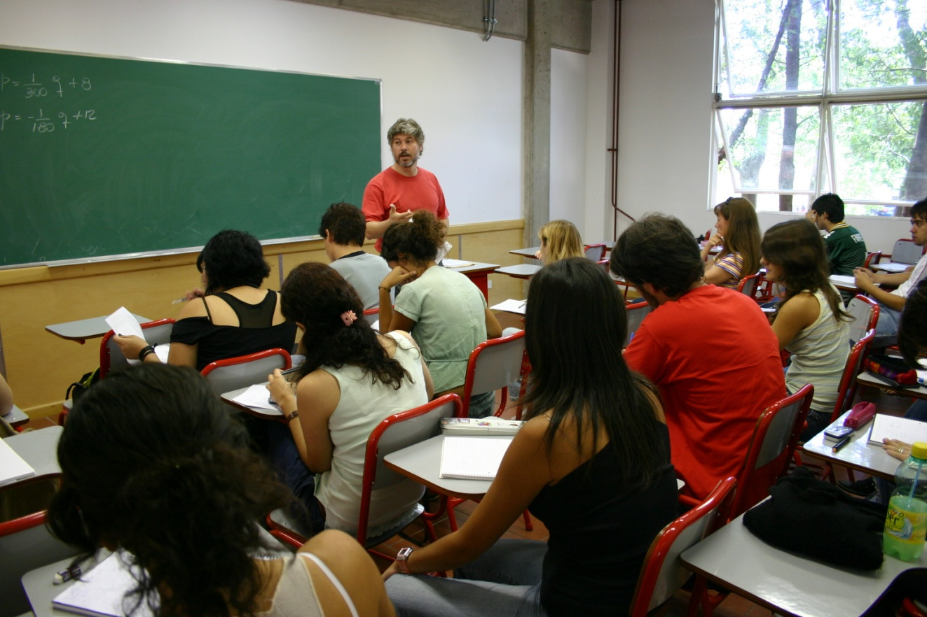
Exspectate paulum, nondum finiimus Wait a moment, we haven’t finished

Slide 29
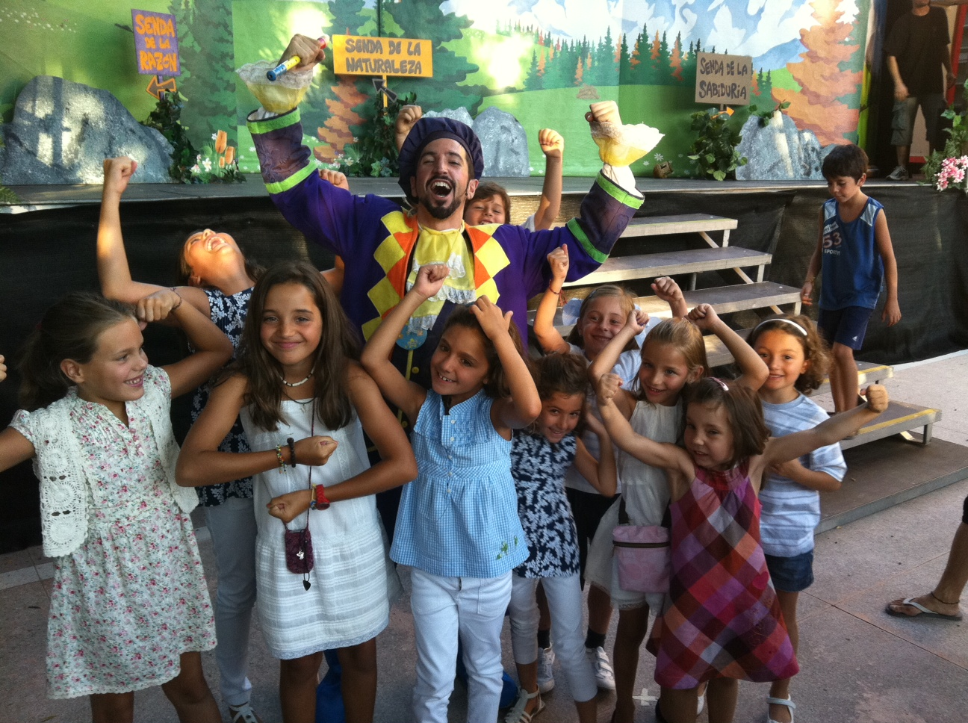
Schola confecta est the lesson is finished

Slide 30
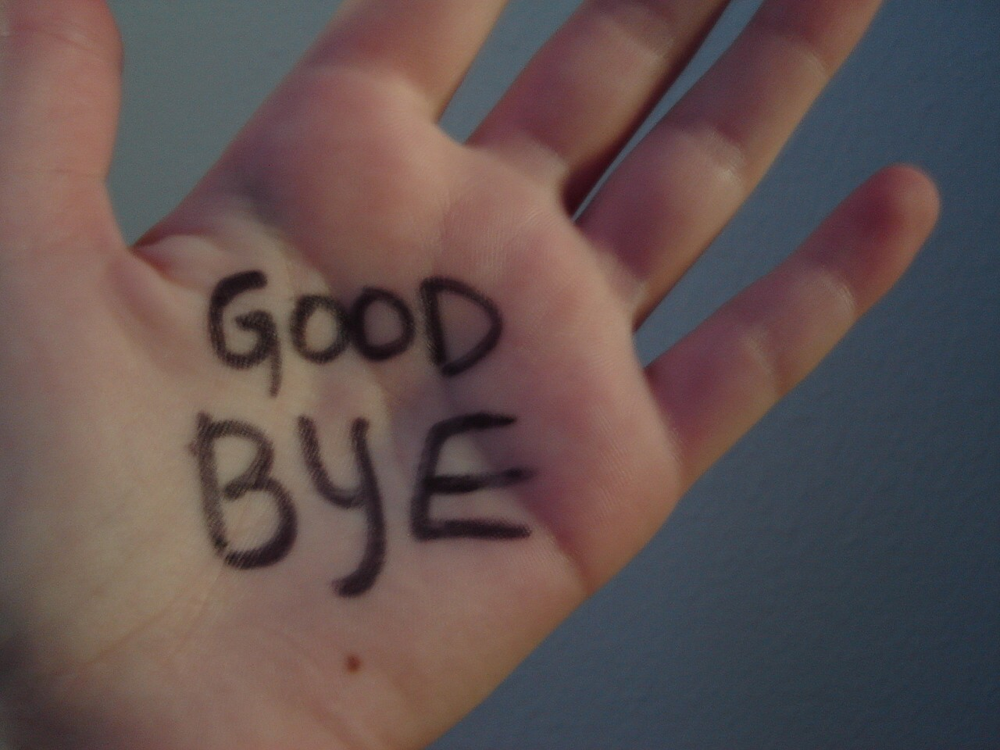
In crastinum see you tomorrow

